Slide 1
Power of Python
Lesson 3: Day 1

Slide 2

This Week: Python
This week, we will expand our toolset by introducing the Python programming language.

Slide 3
Class Objectives
By the end of class today, you will be able to:
Explain how and why Python is used in cybersecurity.
Create and run Python files via the terminal using VS Code.
Use the print() function to print lines to the console.
Use basic Python elements like variables and operators.
Employ the Python input() function to retrieve, store, and utilize user inputs.
Reference and store collections of data using lists.
Create and reference data in dictionaries.
Use listVariable.append(Value), listVariable.index(Value), and listVariable.remove(Value) to add, return, and delete values from a list.
Use len(listVariable) function to return the length of a list.

Slide 4
Raise a Fist
If you’ve never worked with Python and barely know what it is.
Raise a Five
If you work with Python on a daily basis.
Raise a One, Two, Three, or Four
If you fall somewhere in between.

Slide 5
What Is Python?

Slide 6

What Is Python?
Python is a high-level, general purpose programming language used for a variety of applications.
It has an enormous community of developers.
It is used in a wide variety of industries and jobs.
Prioritizes readability for ease of use.

Slide 7

Why Python?
It is the preferred choice over other programming languages on the market for the following 3 reasons:
Python is a high-level, general purpose programming language used for a variety of applications. It has an enormous community of developers with backgrounds in a wide variety of industries and jobs.
The syntax makes it incredibly readable, making it an excellent introductory programming language, while still being immensely powerful. Python forces you to follow certain rules to make the code readable. Well written code makes it easier for everyone to read, which makes team collaboration easier.
Learning Python is a huge competitive advantage for technically oriented cybersecurity jobs.

Slide 8
Why Python?
Learning Python is a huge competitive advantage for technically oriented cybersecurity jobs.
Skill | Number of Job Listings
Information Security | 151,470
Linux | 73,735
Project Management | 69,072
Network Security | 63,519
Cryptography | 53,997
Network Engineering | 47,651
SQL | 43,651
Unix | 40,945
Python | 40,750
Based on national job listings in cybersecurity (Source: Burning Glass)

Slide 9
Bash vs. Python

Slide 10

Bash vs. Python
In reality, we’ll use both Python and Bash.
Bash/Shell Scripts/Unix are used for OS-level interaction, dealing with processes, and interacting with the file system. | Python is preferred for simple or complex logic-based applications, and for automating complex tasks.

Slide 11
Activity: Install Python 3.x
We will be installing the Python programming language.
Macs come with Python installed and most likely it will be the 2.x version. For this class you need 3.x because Python 2.x has different syntax and the code.
Windows users will have to install Python if they haven't already installed it.
Instructions sent via Slack
15 minutes

Slide 12
Your Turn: Install Python 3.x
Instructions:
Check to see if you have Python installed. Follow these steps:
Open a terminal (or Git Bash) window.
Then enter the command: python –version (Windows) or python3 –version (Mac).
If Python 3.x.x is returned then you have the correction version installed. (If you see the phrase Python 2.x.x (or receive an error), install Python using the steps below).
To install Python, follow these steps:
Navigate to the Python website and download the latest version. (https://www.python.org/downloads/)
Complete the default installation steps. Important: Windows users must select the Add Python 3.x to PATH option from the Install Python dialogue.
Check that you have the latest version of Python installed again by opening a terminal or Git Bash window and entering the python --version (Windows) or python3 --version (Mac) command.

Slide 13
VS Code

Slide 14
Python is the programming language.
VS Code is the editor in which we’ll write the code.

Slide 15
Activity: Visual Studio Code
Now that you have the the current version of Python installed, you will then need to install Visual Studio Code. VS Code is the editor we will use to write our code.
Instructions sent via Slack
5 minutes

Slide 16
Your Turn: Install Visual Studio Code
Suggested Time: 5 minutes
Instructions:
01
Go to code.visualstudio.com to download and install the latest version of Visual Studio Code.
02
When the installation is complete, open VS Code and click the Extensions icon in the Activity bar on the side of VS Code.
03
In the search bar, type Python and download the first extension that appears.

Slide 17
Your Turn: Install Visual Studio Code
Instructions:
Go to code.visualstudio.com to download and install the latest version of Visual Studio Code.
When the installation is complete, open VS Code and click the Extensions icon in the Activity bar on the side of VS Code.
In the search bar, type Python and download the first extension that appears.

Slide 18
Hello World!
print (“Hello World!”)

Slide 19
Activity: Goodnight World!
Now that you have seen how to create and run a Python script, you will now make a program of your own and practice running it from within the terminal.
7 minutes

Slide 20
Activity: Goodnight World!
Instructions:
Create a new file in VS Code and save it as GoodnightWorld.py
Write a line of code that will print out the line "Goodnight World!" to the terminal when it is run.
Go to the folder where you saved GoodnightWorld.py and run the application.
Tips:
The print() function allows you to print lines to the console.
Remember to put the phrase in quotes so that it prints properly.

Slide 21
Programming Fundamentals:
Variables and Data Types

Slide 22
Programming Fundamentals
Programming is just piecing logic together to solve larger problems and produce output. All of programming is basically just manipulating data.
Data | Logic
1. Numbers | 1. Operators
2. Strings | 2. Conditionals
3. Booleans | 3. Loops
4. Lists | 4. Functions
5. Dictionaries | 5. Modules

Slide 23

Variables
Variables are the holding ground for data. They essentially allow us to attach specific values to keywords for use later on in an application.

Slide 24
Variables
Variables are the means by which we can store and reference data.
In Python, we assign values to variables.
The assignment statement:
Variable Name | Assignment Operator | Value
name | = | "Fa Mulan"
 |  | The quotes (""), convey that "Fa Mulan" is a string.

Slide 25
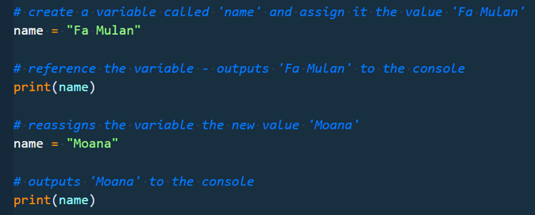
Variables
Variables that have been assigned a value can then be referenced and reassigned in the code later, as shown in the following image:

Slide 26
Basic Variable Types
Basic Variable Types

Slide 27
Variable Types

Slide 28
Integers and Floats
Integers are whole numbers that can be either positive or negative.
While there are limits to how large integers can be in other programming languages, Python allows for integers of any length.
Floats are numbers specified with a decimal point.

Slide 29
Integers and Floats
Integers | Floats
49 | 6.38

Slide 30
Strings
Strings are any collection of characters bounded by a pair of quotation marks.
Strings can contain numbers within them but these numbers are seen as characters without any numeric value.

Slide 31
Strings
Strings are any collection of characters.
"Hello World!"
"13 peas, please."
"#@$^!"

Slide 32
Booleans
Booleans are logic data which denote whether something is considered true or false.

Slide 33
Booleans
Booleans can only have the value true or false
true
false

Slide 34
Operators
Variables and data types can be
altered using operations such as
simple arithmetic and concatenation.

Slide 35
Operators are symbols that alter data.
We’ve already seen an operation when we designated the following value :
The assignment operator = stores a value to a variable
name | = | "Fa Mulan"
There are many more! For example:
Arithmetic: | +, -, *, /, etc.
Comparison: | <, >, ==, !=, etc.
Logical: | and, or, not

Slide 36
Operator Variables
Operator Variables

Slide 37
Questions?

Slide 38
Variable Dissection
Variable Dissection

Slide 39
Activity: Variable Address
Now that we have an understanding of variables and data types we will create some variables for a website, including those that store the daily hits in order to print out a summary of this information.
Instructions sent via Slack
12 minutes

Slide 40
Variable Address
Instructions:
1. Create a variable called URL which will contain a URL in string form.
2. Create a variable called IP_address which will contain an IP address in string form.
3. Create a new variable for each weekday and, using integers, set them equal to how many hits the site got on those days. Note: You can choose an arbitrary number for each.
4. Create a variable called weekly_hits and set it equal to the sum of the hits on each day of the week.
5. Create a variable called average_hits which takes the weekly_hits and divides it by the number of weekdays in a week.
6. Print out each variable to the terminal.

Slide 41
Questions?

Slide 42
User Input

Slide 43
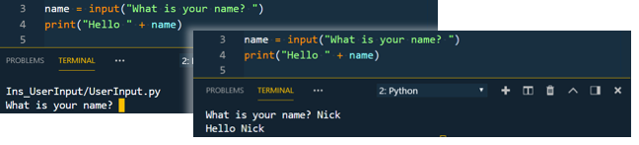
User Input
To get input from the user in Python, use input() and store the result to a variable.
input waits to execute any code following it until after the user has entered a value.
The value always comes back as a string (so you may need to convert it).

Slide 44
User Input
User Input

Slide 45
Activity: Down to Input
In this activity, you will create an application by gathering information from your neighbor and then running some code.
Instructions sent via Slack
10 minutes

Slide 46
Your Turn: Down to Input
Instructions:
1. Create two different variables, user_name and neighbors_name, that will take the input of your first name and your neighbor's first name.
2. Create two more variables, months_you_coded and months_neighbor_coded, that will take the input of how many months each of you have been coding.
3. Create another variable, months_neighbor_coded that combines the total number of months that each of you have been coding.
4. Print out the following two statements:
The first should say: I am [user_name] and my neighbor is [neighbor_name].
The second should say: Together we have been coded for total_months_coded.
Example: “My name is Nick and my neighbor’s name is Jacob. Together we have been coding for 204 months!”

Slide 47
Questions?

Slide 49
Lists

Slide 50
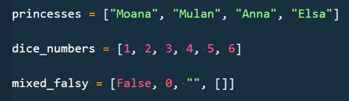
Lists
Lists are collections of data.
These collections can be made up of strings, numbers, booleans, other arrays, dictionaries, etc.
They typically denote related data, e.g. student names, devices connected to network, etc.

Slide 51
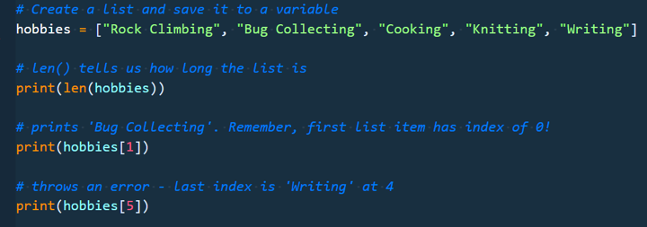
Lists
Each element of the array is marked by an index. Indexes always start at 0.
To reference the value at a specific index you include the name of the list with a square bracket [ ]. Inside the bracket you use the element’s index.

Slide 52
Lists
List Name: zoo_animals
Coded in Python using a List:
Zebra | Rhino | Giraffe | Owl
Index 0 | Index 1 | Index 2 | Index 3
zoo_animals = ["Zebra", "Rhino", "Giraffe", "Owl"]

Slide 53
Lists
[Lists]

Slide 54
Activity: Messy Lists
In this activity, you will be given a large list of IP addresses and will answer some basic questions based on its contents. Afterwards, you will add and remove IP addresses to and from the list.
Instructions sent via Slack
15 minutes

Slide 55
Your Turn: Messy Lists
Instructions:
1. Determine the length of the list and print the length out to the terminal.
2. Determine the indexes for the IPs "82.82.0.22" and "207.209.106.220" and then print the indexes out to the terminal.
3. Add the following IP addresses to the list:
"220.66.146.40"
"245.201.208.161"
"208.222.148.199"
"104.216.140.187"
"73.57.167.115"
4. Remove the following IP addresses from the list:
"53.239.114.76"
"65.136.121.223"

Slide 56
Questions?

Slide 57
Dictionaries

Slide 58

Dictionaries
Dictionaries store data in key-value pairings in which the key is a string that can be referenced in order to collect the value that is associated with it.
pacman = { "isAlive": True, "points": 380, "lives": 7,
}
"isAlive": True,
"points": 380,
"lives": 7,

Slide 59
Dictionaries: Creation
A dictionary is a mapping of keys to values.
You use curly braces, { }, to construct the dictionary.
Values can be any Python value.
Keys are more limited and are typically strings.
keys (strings) | pacman = { "isAlive": True, "points": 380, "lives": 7 } | Values (Booleans, numbers, strings, etc.)

Slide 60
Dictionaries: Referencing
Referencing values in a dictionary is similar to lists. Instead of using a number index, you use the key value. Both use square brackets:
pacman ["isAlive"] | evaluates to | True
pacman ["points"] | evaluates to | 380
keys | pacman = { "isAlive": True, "points": 380, "lives": 7 } | Values

Slide 61
Dictionaries
[dictionaries]

Slide 62
Activity: Hobby Book
In this activity, you will practice creating and accessing your own dictionaries based on your hobbies.
Instructions sent via Slack
15 minutes

Slide 63
Your Turn: Hobby Book
Instructions
Create a dictionary that will store the following:
Your name
Your age
A list of a few of your hobbies
A dictionary of the times you wake up during the week
Print out three statements:
Hello I am (name) and I am a (occupation)
I have (number of) hobbies!
On the weekend I get up at (time)
Use the file provided to help you get started.

Slide 64
We covered a lot today!
Operators
(Arithmetic, Comparison, Logical)
Variable Assignment
and Reference
Data Types and Conversions (Numbers, String, Boolean)
Lists
Dictionaries
User Input

Slide 65
Python Learning Tips
01
Review Immediately. We’ll be building on these concepts quickly. The firmer your grasp now, the better off you’ll be.
02
Redo the exercises from class. Don’t just reread! Spend some time redoing the activities from scratch on your own.
03
Come to office hours. Ask conceptual questions. Ask specific questions. Just keep asking questions!
Don’t Be Afraid. You will get this. It will take time, but you will get this. Keep at it. Patience will pay off.
04
Practice Practice Practice. Only by doing will you learn how to code—reading code and reviewing helps, but writing code is the best way to succeed.
05

Slide 66
Programming Fundamentals We Covered Today:
Data | Logic
1. Numbers | 1. Operators
2. Strings | 2. Conditionals
3. Booleans | 3. Loops
4. Lists | 4. Functions
5. Dictionaries | 5. Modules

Slide 67
Class Objectives
By the end of class today, you will be able to:
Explain how and why Python is used in cybersecurity.
Create and run Python files via the terminal using VS Code.
Use the print() function to print lines to the console.
Use basic Python elements like variables and operators.
Employ the Python input() function to retrieve, store, and utilize user inputs.
Reference and store collections of data using lists.
Create and reference data in dictionaries.
Use listVariable.append(Value), listVariable.index(Value), and listVariable.remove(Value) to add, return, and delete values from a list.
Use len(listVariable) function to return the length of a list.

Slide 68
Any Questions?
See you next class!

